Slide 1
Processes & Threads Processes

Slide 2
Review
Terminology
Kernel mode, User mode
Latency time
Switch user mode ↔ kernel mode
Switch CPU a process to other process together
System Calls

Slide 3
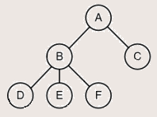
Review
Process:
A program in execution
A program loaded into memory and executing
Associated with each process is set of resources such as executable code, data, stack, CPU registers value, PC, and other information needing to run a program
Associated with each process is its address space (i.e., all memory locations that the process can read and write)
Process table (array or linked list) stores all the information of processes
A process hierarchy (tree)
Tanenbaum, Fig. 1-13.

Slide 4
Objectives
Processes
Definition
The process model
Process creation
Process hierarchies
Process Termination
Process States
Transition States
Implementation of Processes
Degree of multiprogramming

Slide 5
Definition
Processes
OS abstraction to support the ability to have (pseudo) concurrent operation even when there is only one CPU available
An OS consists of a collection of processes: By switching the CPU between processes, the OS can make the computer more productive
An instance of an executing program, including the current values of PC, registers, and variables
A process is not a program on the disk (this is just a file).
Compare with a cake recipe (program) and the activity involving reading the recipe, fetching ingredients, and baking the cake! (process)
A process is a sequential stream of execution in its own address space

Slide 6
Processes
The process model
Early computers allowed only one program to be executed at a time. (quantum or time slice)
The program is a static (inactive) entity, whereas the process is an active one
A process is an activity of some kind
A process has a program, input, output, and a state
There are two parts of a process
sequential execution: no concurrency inside a process; everything happens sequentially (There is only one CPU and one physical program counter)
process state: everything that process interacts with (registers, memory, files, etc)

Slide 7
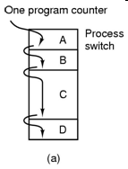
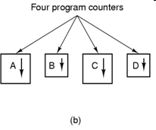
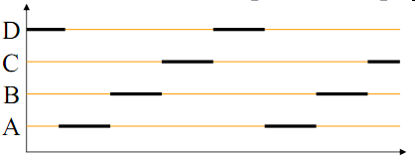
Example
Tanenbaum, Fig. 2-1.

Slide 8
Processes The process model (cont)
Single-processor systems
Pseudo-parallelism
Multiprogramming
Switching among processes (The CPU switches back and forth from process to process)
A single processor may be shared among several processes
Scheduling algorithm
Context switch
Switching the CPU to another process requires saving the state of the old process and loading the save state for the new process
Context switch time is pure overhead because the system does not useful work while switching. It‘s varies depending on the hardware machine
Has become a performance bottle neck

Slide 9
Processes Process Creation
In a general-purpose OS, the principal events that may cause process creation are:
System initialization
Execution of a process creation system call by a running process
A user request to create a new process
Initiation of a batch job
Automatically by the system
At system initialization
Foreground (application) and background (services) processes
By another process
A system call for process creation
Situations
A process needs help doing some computation
A user action – interaction with the shell
In general, a process (parent process) may create new processes (children) via a create-process system call:
fork() and execve() in UNIX
CreateProcess in Win32

Slide 10
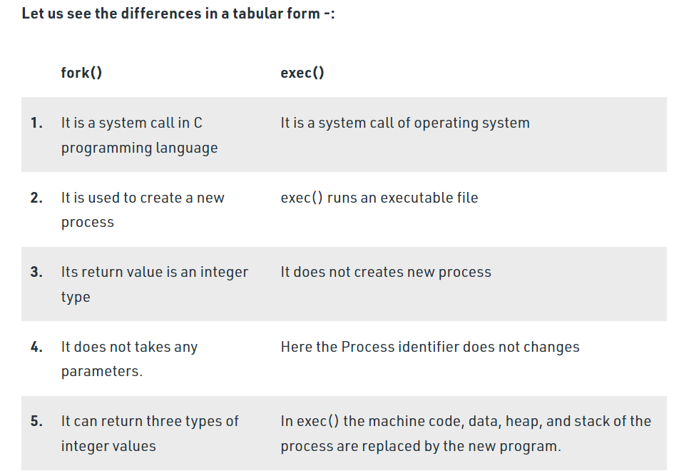

Slide 11
Processes Process Hierarchies
Process hierarchy
Parent–Child Relationship
The child can itself create new processes
Tree of processes
In UNIX OS
A process creates another process, the parent process and child process continue to be associated in certain ways
A process and all of its children and further descendants together form a process group
In Windows OS
All processes are equal (has no concept of process hierarchy)
The parent is given a special token (called a handle) that it can use to control the child

Slide 12
Processes Process Termination
After a process has been created, it may terminate usually due to one of the following:
Normal exit (task accomplished) (voluntary)
Error exit (voluntary)
Ex: inexistent files, insufficient or incorrect input
Fatal error (involuntary)
Ex: illegal instructions, division by zero etc.
Killed by another process (involuntary)
kill system call in Unix, or TerminateProcess in Win32.(in some systems, if the parent terminates)
Voluntary – using a special system call
Involuntary – receiving an interruption

Slide 13
Processes Process States
Running
Using the CPU at that instant (executed by the CPU) (or Instructions are being executed)
Ready
Runnable; temporarily stopped to let another process run; but the CPU available (or The process is waiting to be assigned to a process)
Blocked
Unable to run until some external event happens (or The process is waiting for some event to occur)
New (optional)
Waiting for same resources to be allocated (or The process is being created)
Terminated (optional)
Keeping same information about the exit state (or The process has finished execution)

Slide 14
Processes Transition States
New to Ready or Running
Ready to Running (dispatch)
its turn comes again
selected by the scheduler
Running to Ready (interrupt)
suspended by the scheduler
time slice expired
Running to Blocked (block)
wait for some event to occur
Blocked to Ready (ready)
the awaited event occurs
Running to Terminated (exit)
New
(optional)
Terminated
(optional)
Running
Blocked
Ready

Slide 15
Processes Implementation of Processes
OS maintains a process table
each process is allocate an entry – PCB (Process Control Block) (Where process is located)
used as a repository when the process is suspended or blocked
A PCB contains all the information, that needed (varies from system to system) so that a process can be restarted as if it had never been stopped, such as
Process ID
process state (new, ready, running …)
the value of the CPU registers (PC, Stack Pointer, other register)
CPU scheduling information (process priority etc.)
memory management information (pointers etc.)
accounting information (the amount of CPU and real time used, time limits etc.)
I/O status information (outstanding I/O req., I/O devices allocated, list of open files etc.)
Process parent Id, process group ...

Slide 16
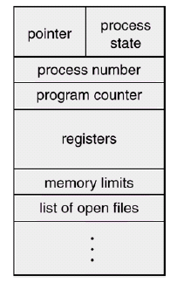
Processes Implementation of Processes (cont)
A PCB block

Slide 17
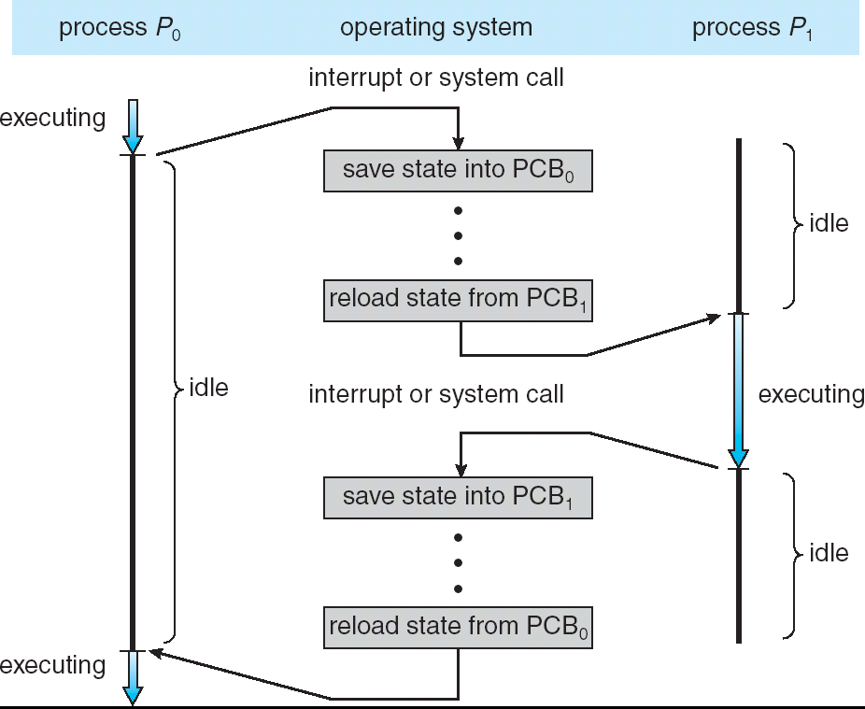
Processes Implementation of Processes (cont)
Example

Slide 18
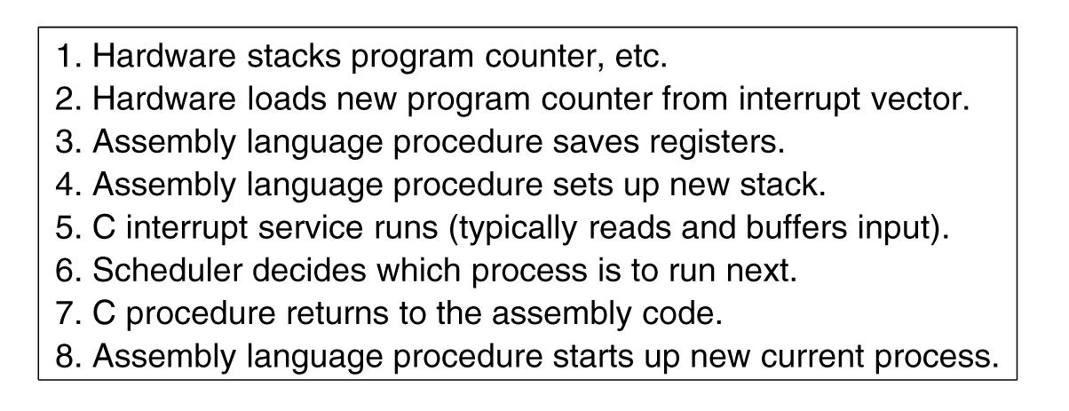
Processes Implementation of Processes (cont)
Interrupt handling and scheduling are summarized
Tanenbaum, Fig. 2-5.

Slide 19
Processes Degree of multiprogramming
Shows the CPU utilization
CPU utilization = 1 - p^{n}
p: time waiting for I/O to complete
n: number of processes
Example
A computer has 512MB of memory, with OS taking 128 MB and each user program also taking up 128MB with an 80% average I/O wait
CPU utilization = 1 – 80%^{((512-128)/128)} = 49%
Adding another 512MB,
CPU utilization = 1 – 80%^{((1024-128)/128)} = 79%

Slide 20
Summary
Processes
Q&A

Slide 21
Next Lecture
Threads

